Slide 1
Predicting Heart Disease with Machine Learning
Presented by
22026A0501 S Chandra Venkata Sai
22026A0515 A Yasoda Kishore
22026A0517 M Aditya Mani Krushna

Slide 2
Why this Matters “A Healthy Heart Can’t Wait”
Heart disease is the #1 cause of death worldwide.
Early prediction can save lives.
Let’s see how machine learning can help.

Slide 3
Our Mission “Can Data Help Us Detect Danger Early?”
Build a smart system to predict heart disease
Use real medical data
Make it simple for anyone to use

Slide 4
Meet the Dataset “The Clues from Real Patients”
Source: heart.csv from Kaggle
Goal: Predict 1 (disease) or 0 (healthy)

Slide 5
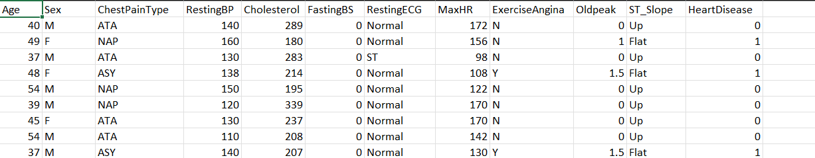
ATA(Typical Angina), NAP(Non-anginal pain), ASY(Asymptomatic), REST(Resting Pain)
Normal, ST, LVH(Left Ventricular Hypertrophy)
Up, Flat, Down
1 : > 120 mg/dl
0 : <= 120 mg/dl

Slide 6
Cleansing the Data “Turning Raw Data into Gold”
Split into Train/Test (80/20)
Encoded categorical data using One Hot Encoding
Scaled features using Standard Scaler
Tools: Column Transformer, Pipeline.

Slide 7
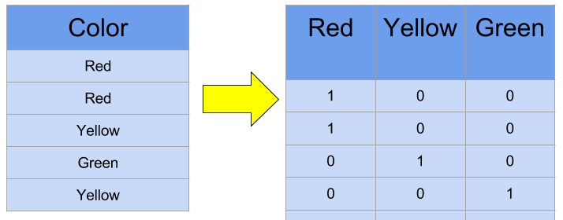
How does One-Hot Encoding work? “Understanding How Distinct Values Become Unique Columns”

Slide 8
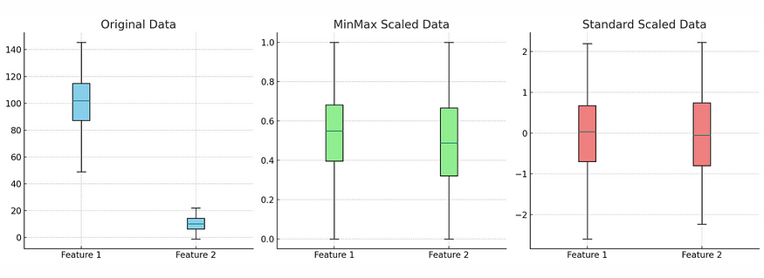
How does the Scaling of Data work? “The Process of Bringing Variables to a Common Ground”

Slide 9
The Brain of Our Project “The Machine Behind the Prediction”
Trained multiple classification models (Logistic Regression, Random Forest, etc.)
Used GridSearchCV for hyperparameter tuning.
Gradient Boosting gave the best accuracy on the train and test sets.
Saved the final model as ‘models.pkl’ and preprocessing as ‘pipeline.pkl’

Slide 10
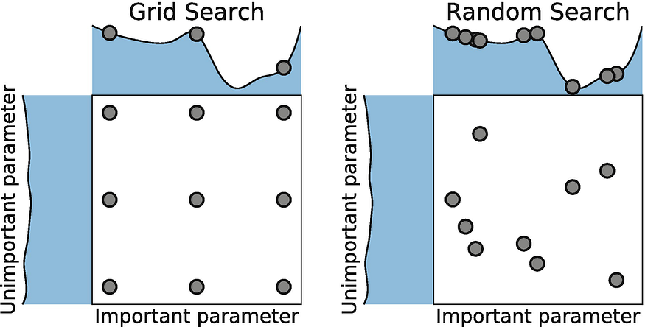
Grid Search VS Random Search “Two Ways to Tune”

Slide 11
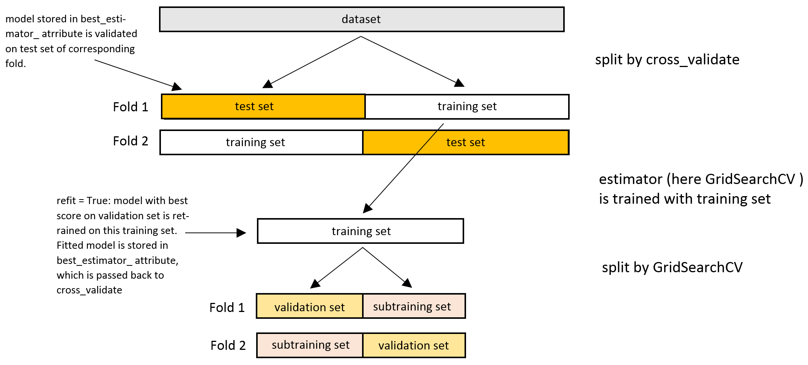
Grid Search CV “Finding Good Parameters Reliably”

Slide 12
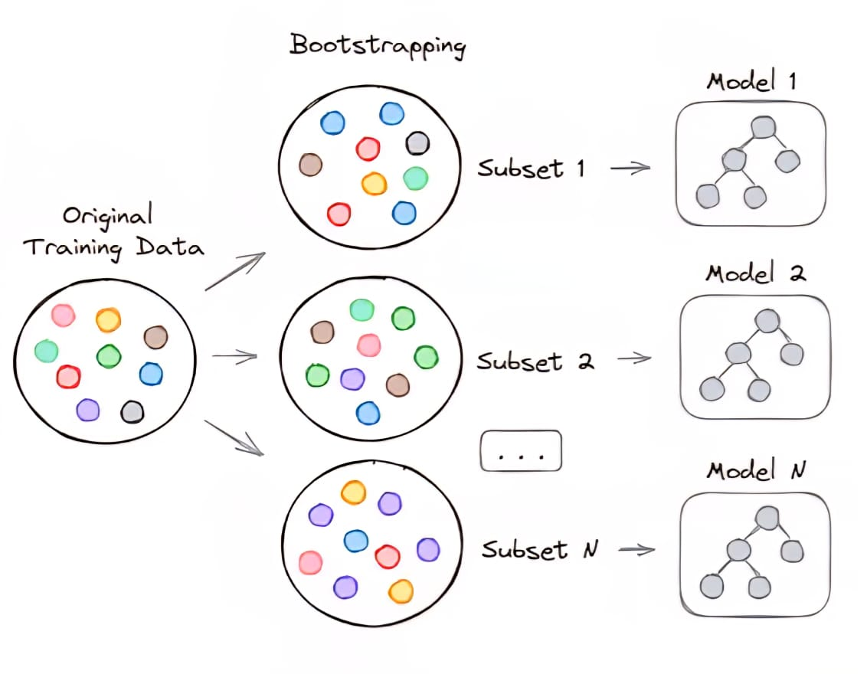
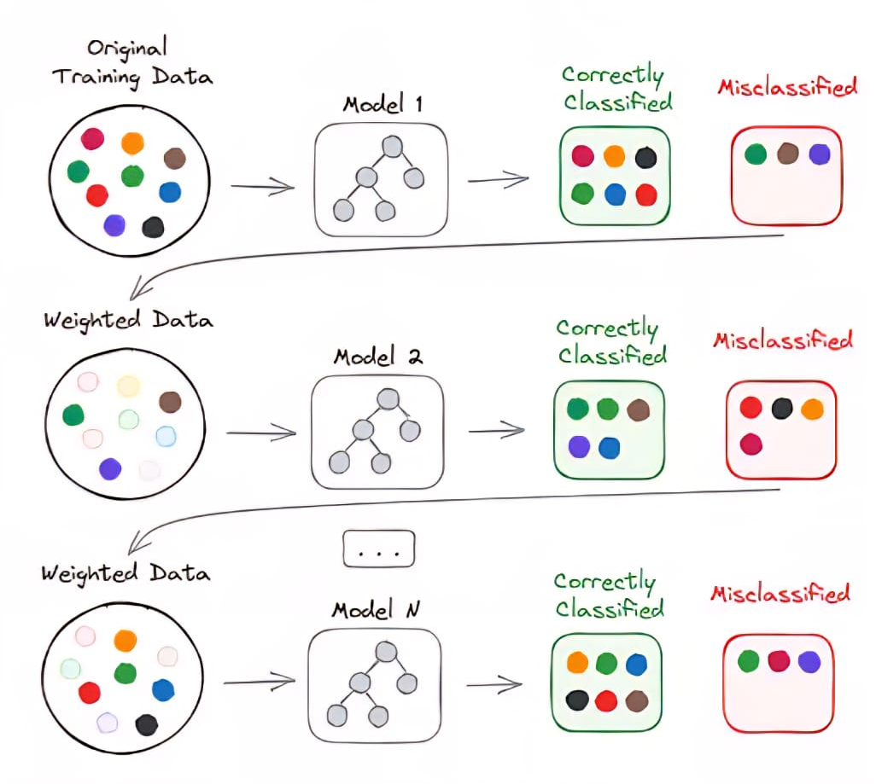
Bagging VS Boosting “Two Ways to Combine Models”

Slide 13
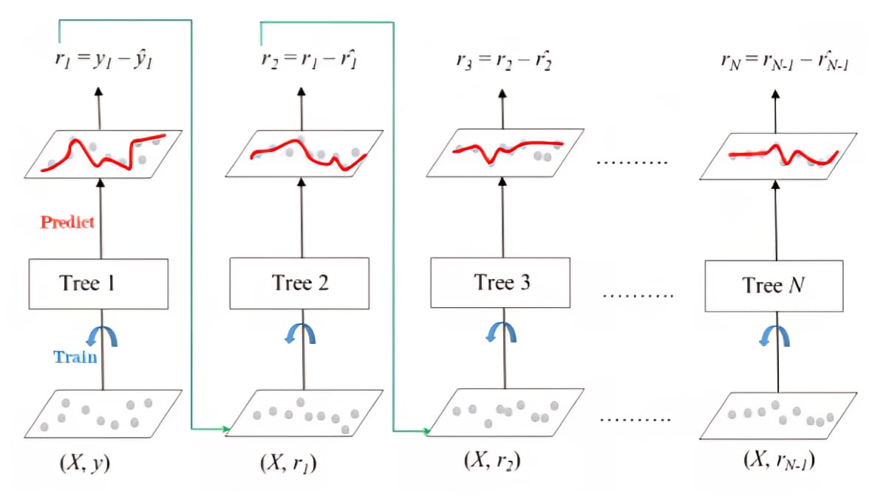
Gradient Boosting “The Accuracy Booster”
Fits new models to the residual errors of previous models.

Slide 14
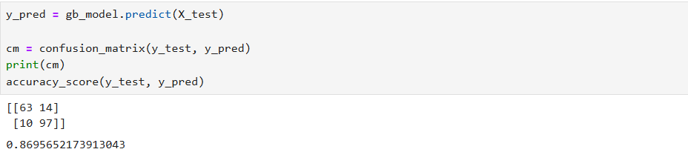
How Good is it? “Measuring Its Intelligence”
Accuracy and Confusion Matrix

Slide 15
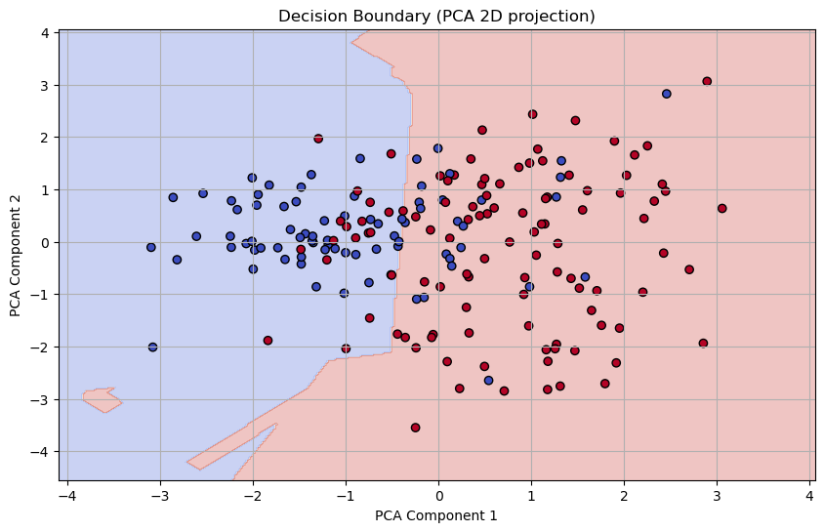
Visualization of Decision Boundary with PCA “The Two-Dimensional View of High-Dimensional Choices”

Slide 16
The App in Action “ML Meets Real Users”
Built with Streamlit
Users enter health metrics
Returns Heart Disease Risk instantly

Slide 17
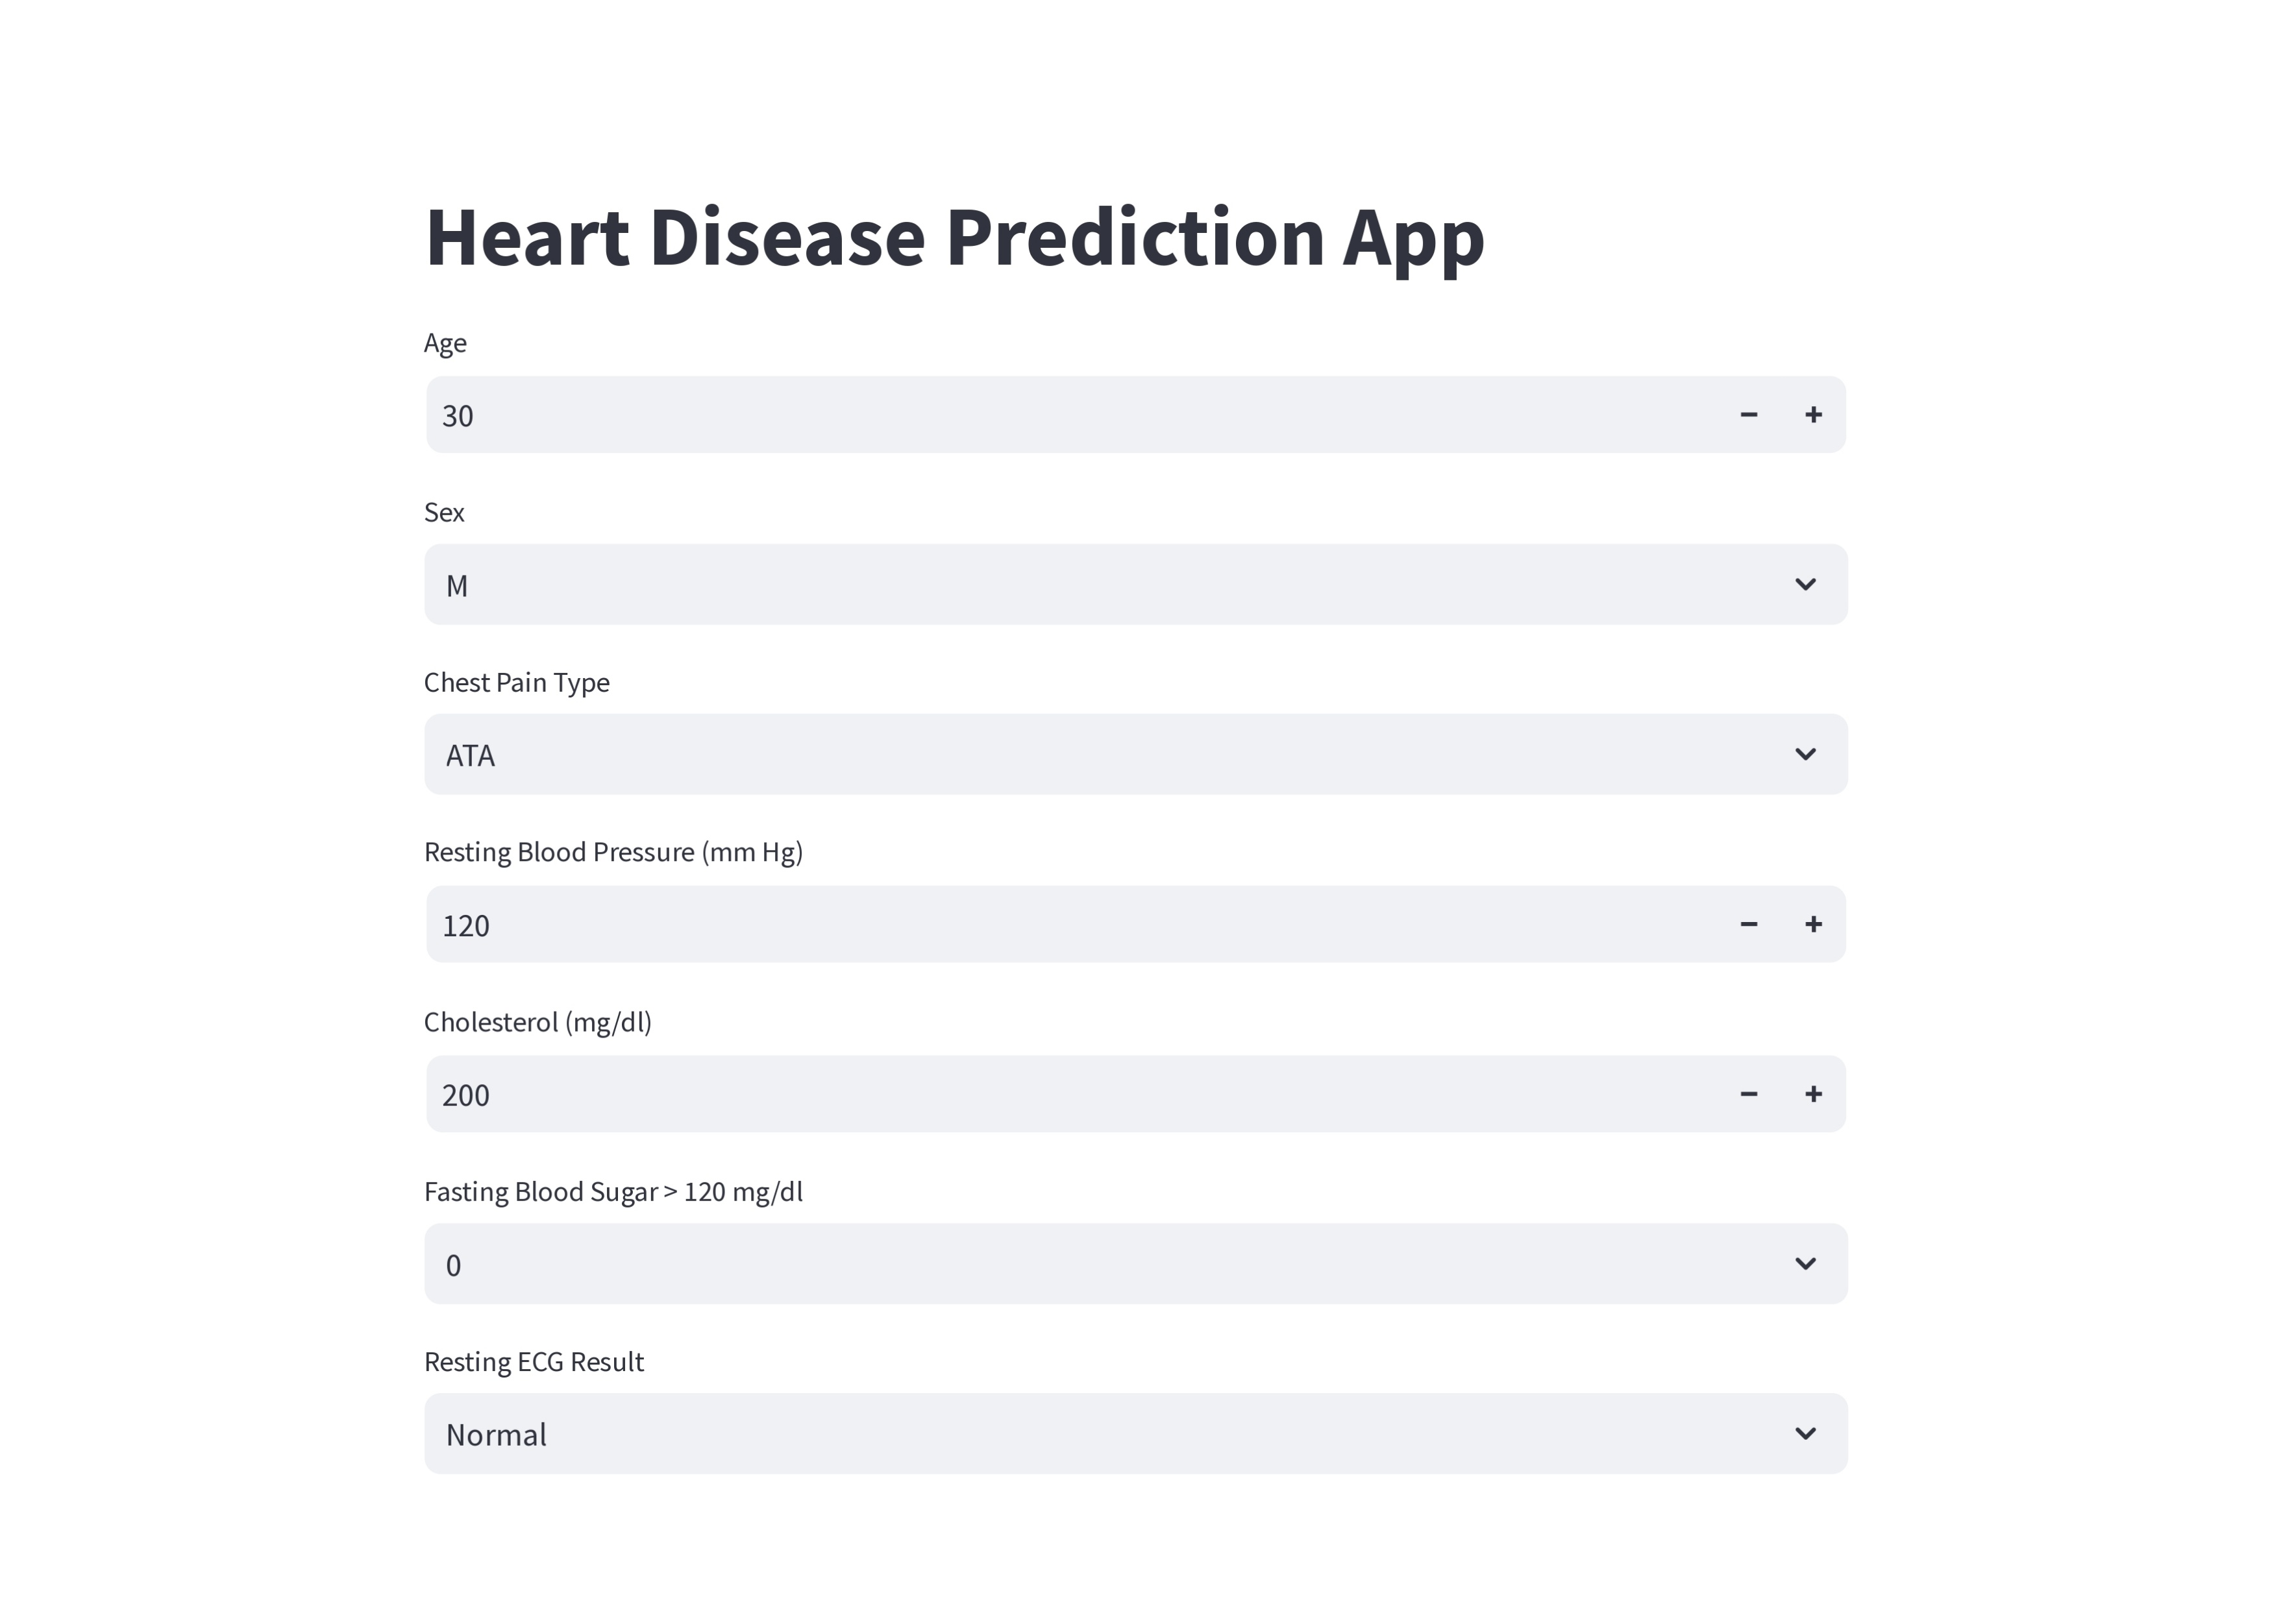

Slide 18
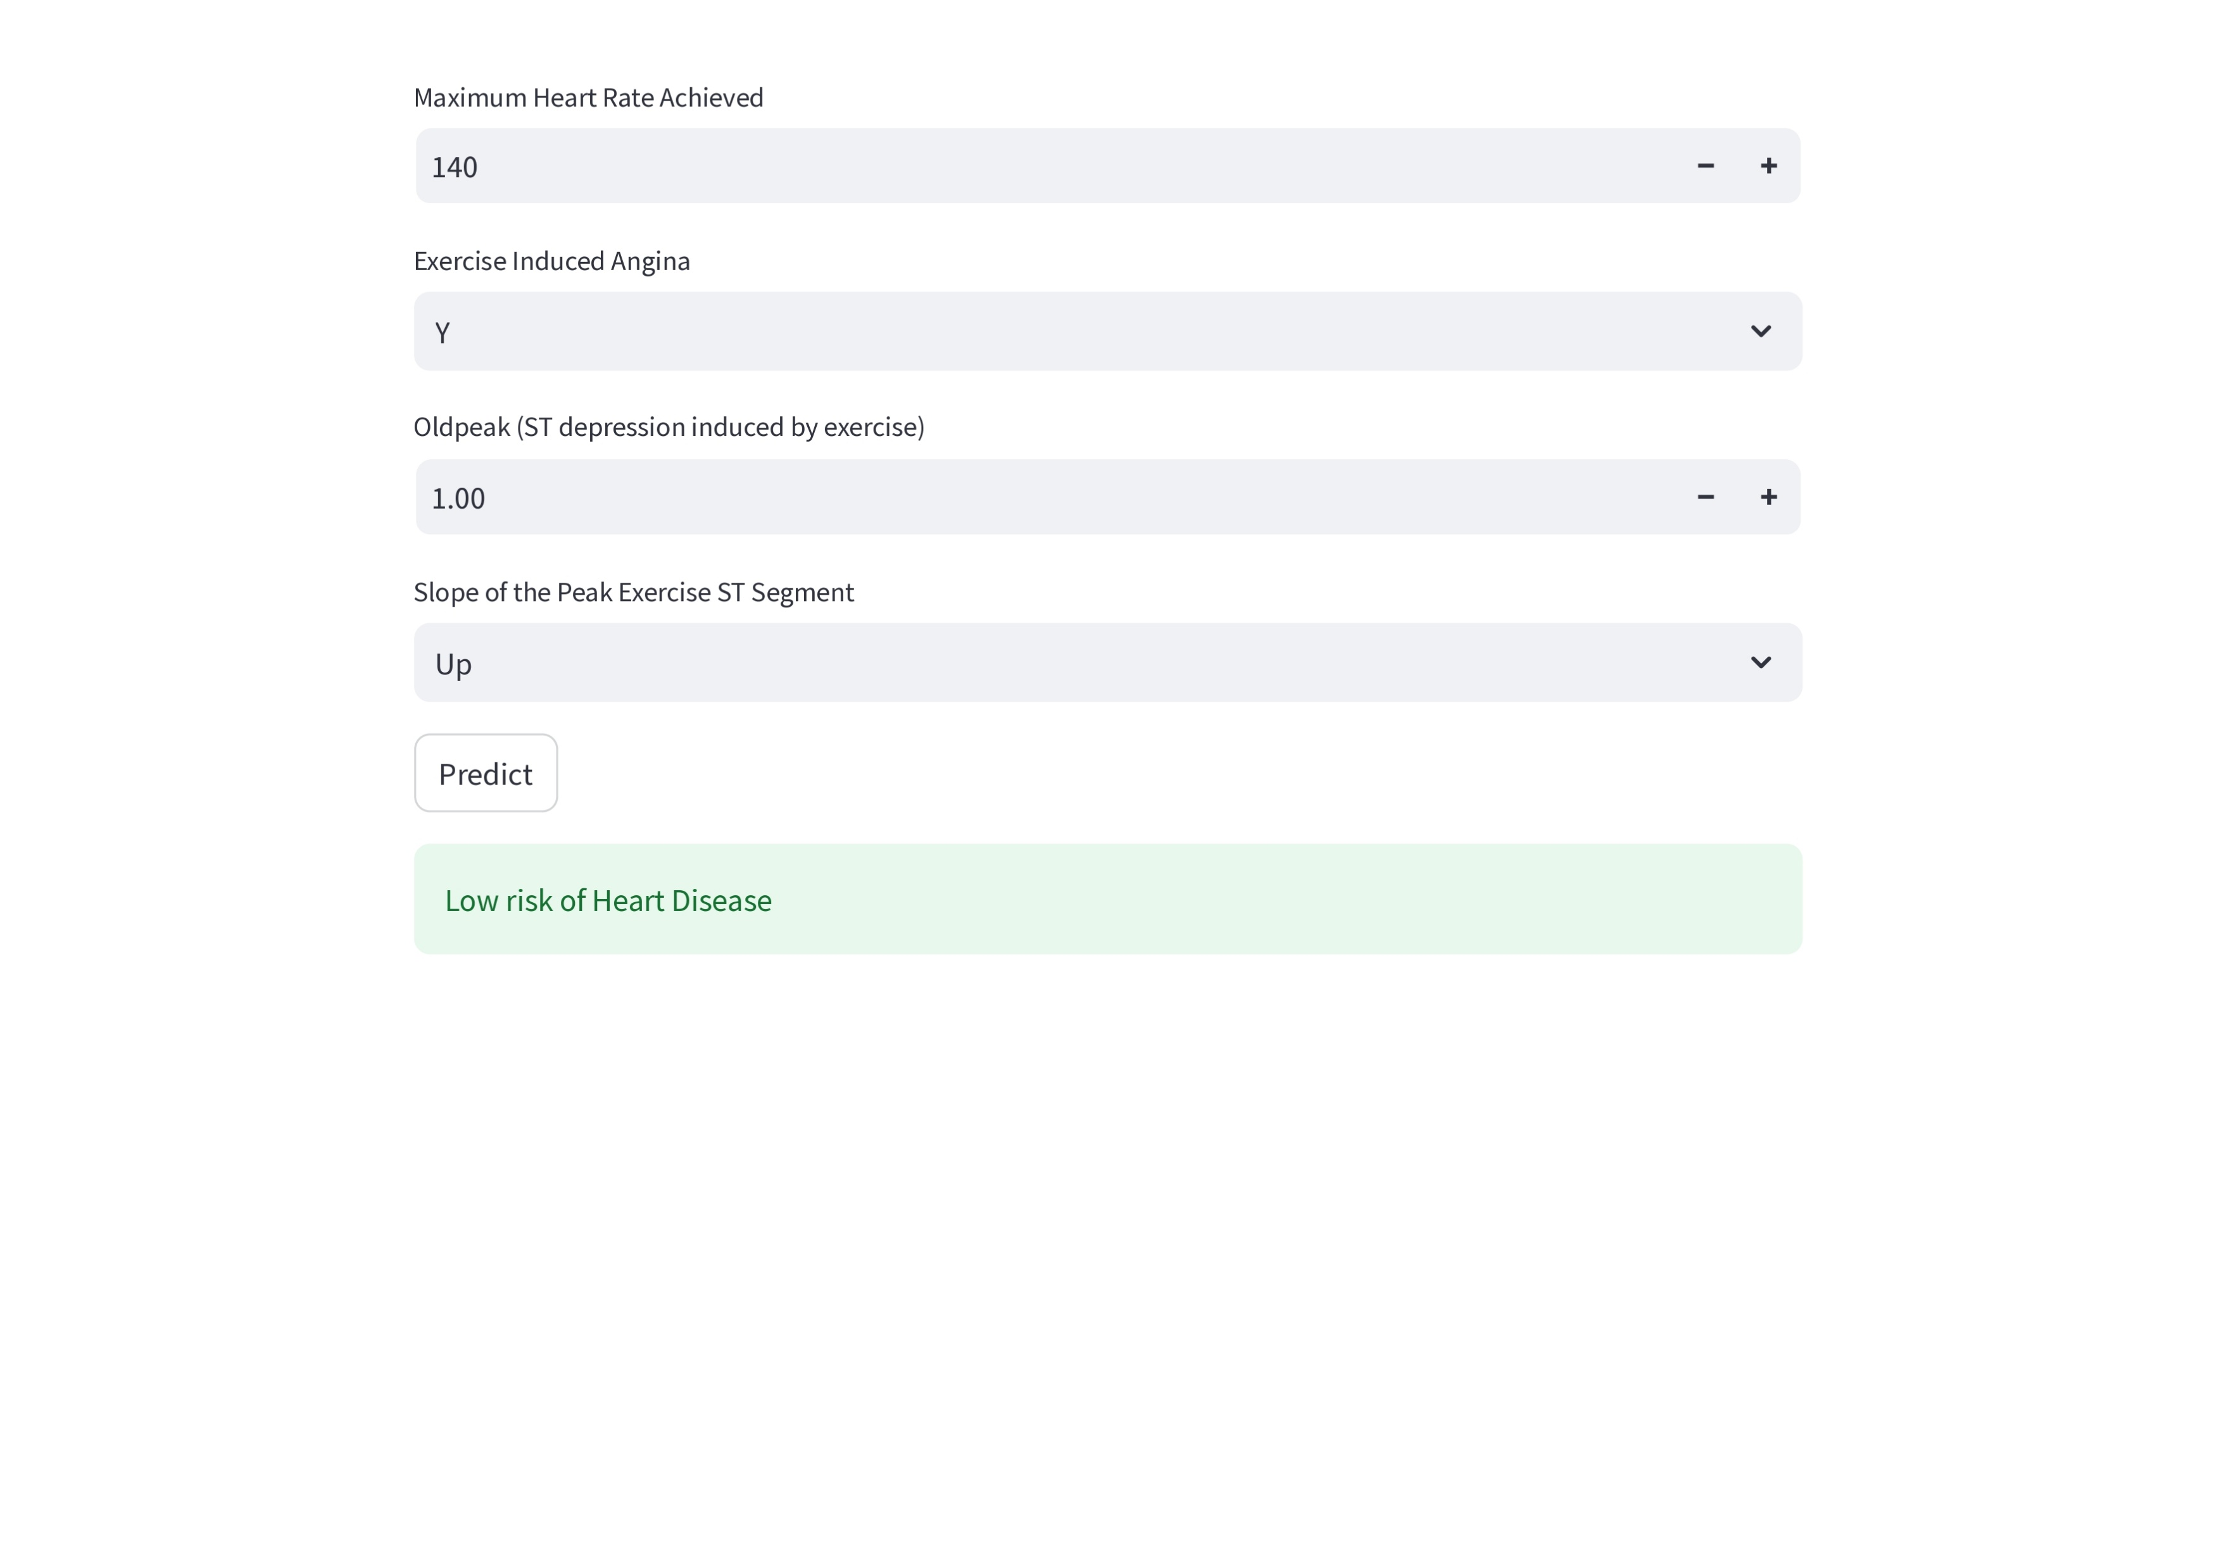

Slide 19
What’s Next? “From College Project to Real-World Tool”
Use larger datasets
Improve model tuning
Deploy online or on mobile

Slide 20
Thank You

